Slide 1


SOFTWARE ENGINEERING (Week-3)
Usama Musharaf
Lecturer (Department of Computer Science)
FAST-NUCES Peshawar

Slide 2
Contents of week # 3
Software Quality Engineering (Cont….)
Quality Engineering at Requirement phase
Requirement Document
Requirement Engineering Related Activities
Requirement Traceability Matrix
Intro to Software Architecture
Conceptual Model of Architecture Representation
Architectural Views
Views and View Point
4+1 View Model
Discussion on Uber Case Study (System Design)

Slide 3
Software Quality Engineering at Requirement Phase

Slide 4
Software Quality Engineering Road Map
Quality Engineering at every SDLC phase:
Quality Engineering
Requirement Analysis
Quality Attributes
Design
Version Controlling
GIT, GIT Hub
Code
Unit Testing
(JUnit)
Testing
Docker Containers
Defects
Deployment

Slide 5
The Requirements Process (Process for Capturing Requirements)
Performed by the req. analyst or system analyst
The final outcome is a Software Requirements Specification (SRS) document

Slide 6
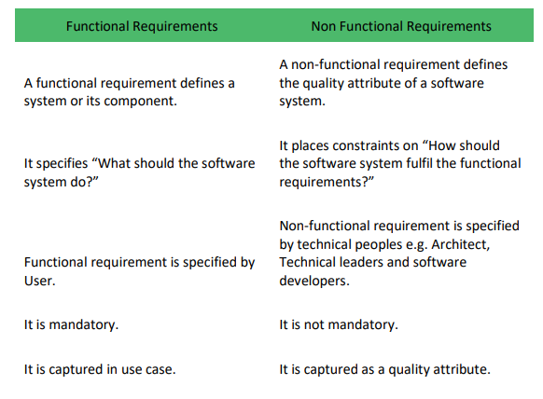

Slide 7
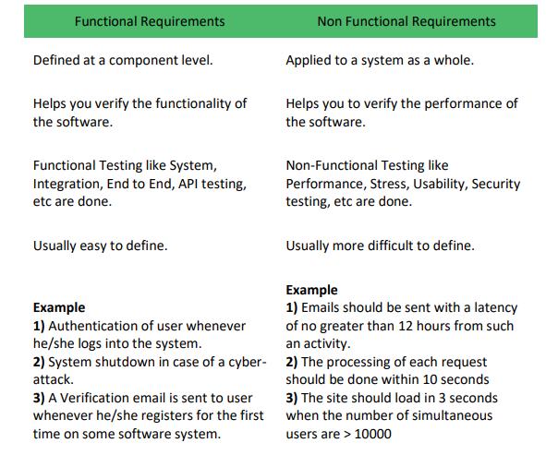

Slide 8
What is Defect?
Defect is deviation from customer requirement.
Mostly defects are found in the software after software is shipped to the customer at production site.
Example:
In online shopping, the option of searching a debit card for making payment is missing.

Slide 9
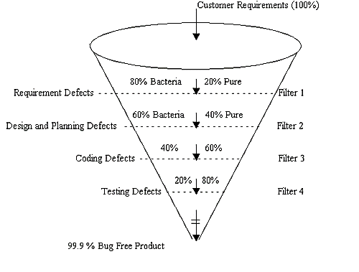
Defects

Slide 10
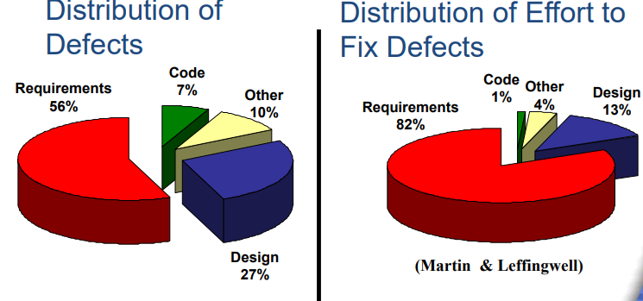
Distribution of Defects

Slide 11
Failure Root Cause
Standish Group in 1994 study three most commonly factors that cause projects to be challenged
Lack of User Input
Incomplete Requirements & Specification
Changing Requirements and Specification

Slide 12
Failure Root Cause
Standish Group Study in 1994:
Observation for Failure: Why 1/3 Projects run in trouble, it is directly related to
Requirements Elicitation
Requirement Documenting
Requirement Management
Standish Survey: Coding issue were a “non-problem.

Slide 13
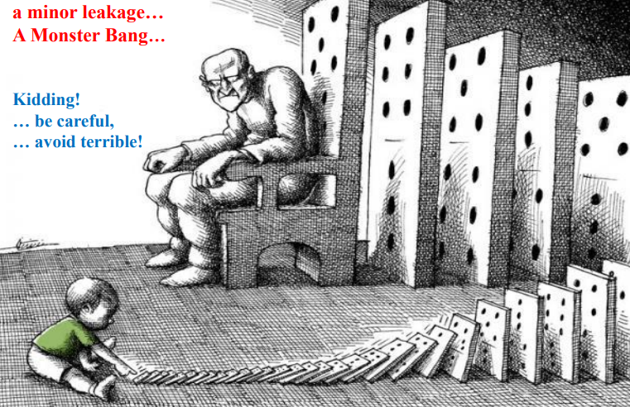

Slide 14
Impact of Requirement Defects
Leakage into other phases
Design, Code, Implementation, Maintenance etc.
Impact
re-requirement,
re-design,
re-code,
Re-testing,
re-implementation,
re-deployment, re-training .
increase cost, extra support & service cost.

Slide 15
What are Missing Quality Requirements?
In a real-time scenario, more budgets mean more quality. This is both theoretically and practically true.
Putting in more money for quality of the software product will result in low probability of product failure and may save a lot of financial resources as the high quality product will be immune to threats.
Prioritize areas which are non-negotiable.
For example, a software product with excellent User Interface (UI) but with no firewall for database security will face more threats. So adding a firewall to ensure Database is secure is more important than spending budget on cosmetic changes in UI.

Slide 16
Missing Quality Requirements
Lack of quality in any product can lead to massive losses but when we talk about lack of quality in software products, we can expect catastrophe. One such scenario occurred when Hackers access personal information associated with at least a half billion Yahoo accounts. This incident was report in 2016 but occurred sometime in late 2014.
What was the ramification? Prior to the announcement of the breach, Verizon negotiated and decided to purchase Yahoo for $4.8 billion and this deal was to be closed in March 2017. But later in February 2017, Verizon and Yahoo announced that the deal will still go forward, but dropping the sale price by $350 million.
On the other side, user’s confidential information including email, credit card details, bank account details and many others hit the market putting millions of users on stake

Slide 17
Cost Analysis based Approach
Missing Quality in Software Application has direct impact on People and Organizations as seen by the example mentioned previously.
According to Eppler and Helfert principles the costs are classified in two categories:
Direct Cost of missing Quality
In-Direct Cost of missing Quality:

Slide 18
Cost Analysis based Approach
Direct Cost of missing Quality
Direct Costs, as the name suggest, are directly linked to the missing quality. The direct costs are effects that are easily observable/measureable and they occur immediately after any unfortunate event. Examples includes; financial loss & physical injury and related. In short, direct costs are visible and measureable.

Slide 19
Cost Analysis based Approach
Indirect Cost of missing Quality
Indirect Costs are invisible cost of missing quality and hence difficult to calculate. It is also, sometime, difficult to realize or identify as they occur after a long time of the incident. Example includes: Loss of market share or reputation, loss of market and shareholders trust and investment. Opposed to the direct cost, these are invisible as they may remain hidden for pretty long time, may have long-term impact as well.
Scenario of Nokia serves a good example, its CEO said in May-2016 in his farewell speech: “We didn’t do anything wrong but somehow we Lost”.

Slide 20
RE Related Activities
Functional Requirements: describes what a software system should do
Non-Functional: place constraints on how the system will do so.
Business Processes: procedure or event with the purpose of reaching a goal
Scope: required tasks to accomplish, boundary of system
Goals: An observable and measurable end result having one or more objectives to be achieved within a more or less fixed timeframe
Stakeholders: person, group or organization that has interest or concern in an organization
Sources: someone or something that provides what is wanted or needed i.e. human, documents, context, situational factors, application types etc.
Feasibility study: a feasibility study is an analysis of the viability of an idea

Slide 21
RE Related Activities
GUI: Graphical User Interface
Traceability: concerned with documenting the relationships between different development artifacts (i.e. requirements and other artifacts).
Measureable: objectives should be measurable and achievable
Domain: area, business, discipline, field, realm, sphere
Prototyping: An easily modified and extensible model (representation, simulation or demonstration), partial or approximation of final product, useful for clarifying requirement.

Slide 22
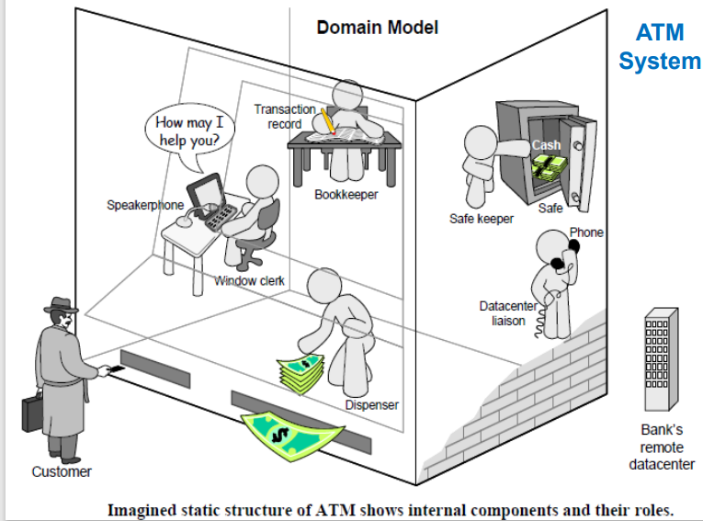

Slide 23
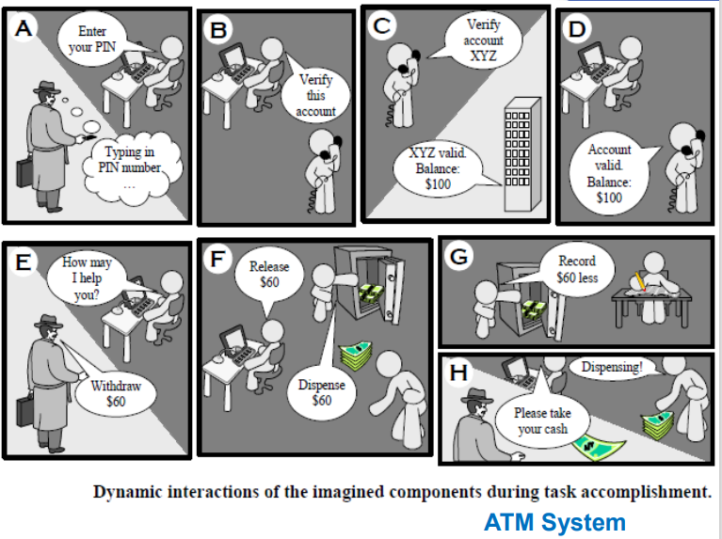

Slide 24
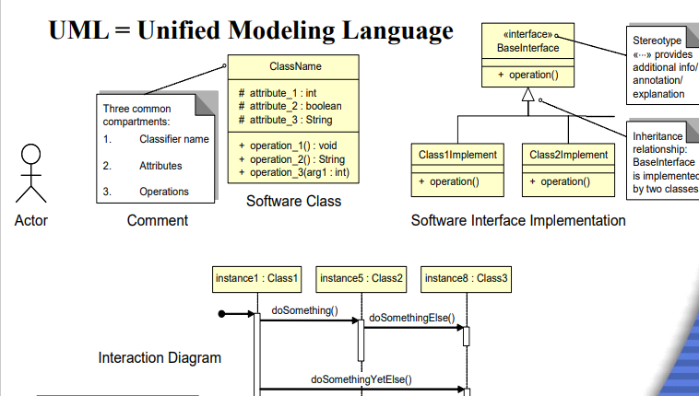

Slide 25
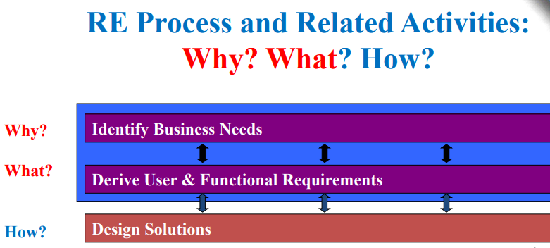

Slide 26
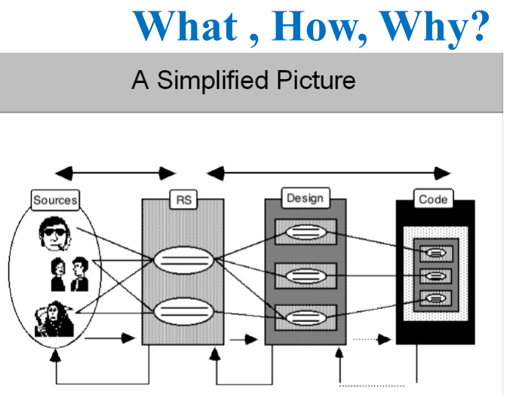

Slide 27
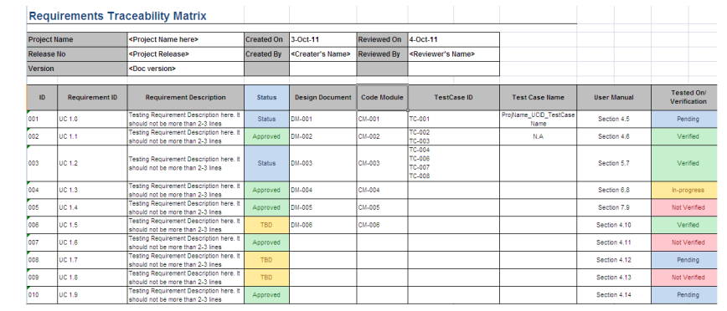

Slide 28
Software Architecture

Slide 29
Software Architecture
The software architecture of a program or computing system is the structure or structures of the system, which comprise software components, the externally visible properties of those components, and the relationships between them.

Slide 30
Conceptual Model of an Architecture Description
ISO/IEC/IEEE 42010

Slide 31
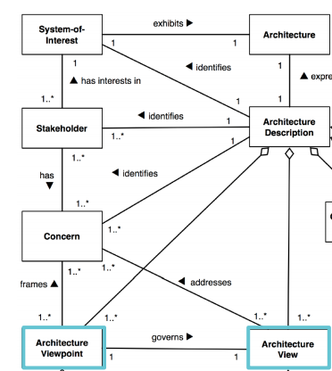

Slide 32
Introduction to Views
Dictionary Meaning
Manner of looking at something
Why (multiple) view ?
For better understanding and managing.
Multi dimensional view must be taken for any complex entity because of its complex nature ,
It can’t be described in 1 dimensional view.

Slide 33
Introduction to Views
For example, In civil what are the views of a building…
Room layout
3D view of building / room
Electrical diagram
Plumbing diagram
Security alarm diagram
AC duct diagram etc…etc…
Which of the above view is Architecture?
In Software, What are views ? ………..

Slide 34
Definition of SW View
As per IEEE definition,
Software architecture descriptions are commonly organized into views,
Each view addresses a set of system concerns, following the conventions of its viewpoint.
Viewpoint - A position or direction from which something is observed or considered;
View – Details or full specification considered from that viewpoint

Slide 35
So, a view of a system is a representation of the system from the perspective of a viewpoint.

Slide 36
Architecture
1
M
Views
1
Viewpoints
M

Slide 37
View Model
Software designers can organize the description of their architecture decisions in different views.

Slide 38
4+1 view model
The 4+1 view is an architecture verification technique for studying and documenting software architecture design.

Slide 39
The 4 +1 View Model
The 4+1 view model was originally introduced by Philippe Kruchten (Kruchten, 1995).
The model provides four essential views:
the logical view,
the process view,
the physical view,
the development view
and fifth is the scenario view

Slide 40
4+1 View Model of Architecture
Logical view
Development view
Scenarios
Process View
Physical View

Slide 41
The 4+1 view model
Multiple-view model that addresses different aspects and concerns of the system.
Standardizes the software design documents and makes the design easy to understand by all stakeholders.

Slide 42
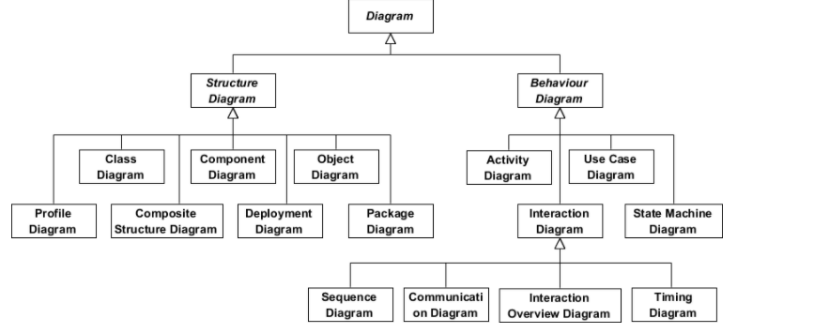

Slide 43
The Scenario View- Use Case View
The scenario view describes the functionality of the system, i.e., how the user employs the system and how the system provides services to the users.
It helps designers to discover architecture elements during the design process and to validate the architecture design afterward.

Slide 44
Use Case
They use case view illustrates the functionality of the system.
Using use case we can capture the goals of the user or what the user expects from the system.
In UML, Use Cases can be created through use case diagrams or use case descriptions
Use cases can be created by analysts' architects or even by the users.

Slide 45
The Logical or Conceptual View
The logical view is based on application domain entities necessary to implement the functional requirements.
The logical view specifies system decomposition into conceptual entities (such as objects) and connections between them (such as associations).

Slide 46
Logical view
The logical view shows the parts that make up the system and how they interact with each other.
It represents the abstractions that are used in the problem domain
These abstractions are classes and objects
Different UML diagrams show the logical way such as class diagram state diagram sequence, diagram communication diagram and object diagram.
Logical view
class diagram
state diagram
Sequence diagram
communication diagram
object diagram

Slide 47
The Development or Module View
The development view derives from the logical view and describes the static organization of the system modules.
UML diagrams such as package diagrams and component diagrams are often used to support this view.

Slide 48
Development View
The development view describes the modules are the components of the system.
This might include packages or libraries.
It gives a high-level view of the architecture of the system and helps in managing the layers of the system.
UML provides two diagrams for development view.
component Diagram
package Diagrams
Development View
Component Diagram
Packages Diagram

Slide 49
The Process View
The process view focuses on the dynamic aspects of the system, i.e., its execution time behavior.
This view maps functions, activities, and interactions onto runtime implementation.

Slide 50
Process View
Then we have the process view
Through this view, we can describe the processes of the system and how they communicate with each other using process
Using process view, we can find out what needs to happen to the system
So using process view we can understand the overall functioning of the system
Activity diagram in UML represents the process view
Process view
Activity Diagram

Slide 51
The Physical View
The physical view describes installation, configuration, and deployment of the software application.
It concerns itself with how to deliver the deploy-able system.
The physical view shows the mapping of software onto hardware.

Slide 52
Physical View
The physical view is the view that models the execution environment of the system
Using this view, we can model the software entities onto the hardware that will host and run the entities
The physical view in UML is represented through deployment diagrams
Physical view
Deployment Diagrams

Slide 53
Uber Case Study

Slide 54
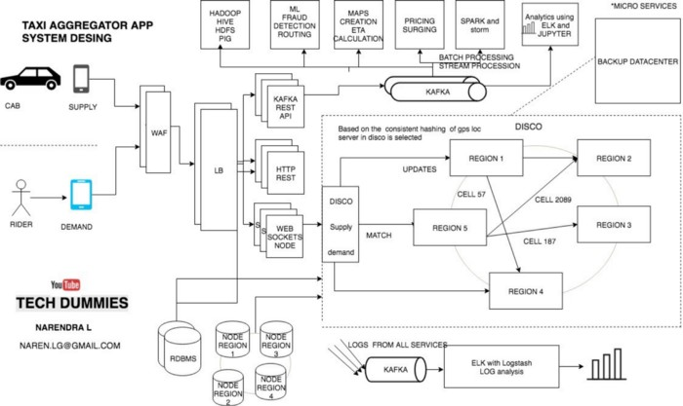

Slide 55
Ubers Case Study
Uber’s technology may look simple but when A user requests a ride from the app, and a driver arrives to take them to their destination.
But Behind the scenes, however, a giant infrastructure consisting of thousands of services and terabytes of data supports each and every trip on the platform.
Like most web-based services, the Uber backend system started out as a “monolithic” software architecture with a bunch of app servers and a single database.

Slide 56
Ubers Services
The challenging thing is to supply demand.
So we need two services
Supply service
Demand service

Slide 57
Ubers Services
Supply service
The Supply Service tracks cars using geolocation (lat and lang).
Every cab which is active keep on sending lat-long to the server every 5 sec once.
Demand service
The Demand Service tracks the GPS location of the user when requested.
Now we have supply and demand. all we need a service which matches they demand to a supply and that service in UBER is called as Dispatch Optimization.

Slide 58
How Dispatch System Works? How Riders match to drivers?
GPS/ location data is what drive dispatch system, that means we have to model our maps and location data.
The earth is a sphere. It’s hard to do summarization and approximation based purely on longitude and latitude.

Slide 59
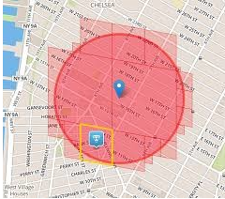
How Dispatch System Works? How Riders match to drivers?
So Uber divides the earth into tiny cells using the Google S2 library. Each cell has a unique cell ID.
S2 can give the coverage for a shape. If you want to draw a circle with a 1km radius centered on London, S2 can tell what cells are needed to completely cover the shape.

Slide 60
How Dispatch System Works? How Riders match to drivers?
ETA (Estimated Time to Arrival)
To compute the ETA of how nearby they are not geographically, but by the road system.

Slide 61
Web Application Firewall
A web application firewall (WAF) is a firewall that monitors, filters and blocks requests from
block IPs
Bots
Or where UBER service is not launched yet

Slide 62
Load Balancing
Load balancing refers to efficiently distributing incoming network traffic across a group of backend servers, also known as a server farm or server pool.

Slide 63
Supply/ Demand

Slide 64
HAVE A GOOD DAY!

